Slide 1
Failed Banking Transaction Analysis
By Kavya Meda

Slide 2
abstract
The Failed Banking Transaction Analysis project processes transaction data from multiple bank branches, uploaded as CSV files to a cloud storage bucket. Using PySpark on a Dataproc cluster, the data is cleaned, combined, and filtered for failed transactions. The results are stored in Cloud SQL (MySQL) and analyzed with BigQuery to identify patterns and improve transaction success rates.

Slide 3
Technologies and Tools Used
Google Cloud Storage To store CSV files from bank branches (input data and PySpark scripts).
gsutil (GCP CLI Tool) To upload files from local system to Cloud Storage bucket.
PySpark on Google Cloud Dataproc (Single Node Cluster)
First Job: Clean and merge multiple CSVs into one (remove null and blank rows).
Second Job: Filter failed transactions from the cleaned data.
Cloud SQL – MySQL Store filtered failed transaction records into a table for further use.
BigQuery Used for querying, analysis, and visualizing the data stored in Cloud SQL.
CSV Format Used for daily transaction files input from bank branches.

Slide 4
Cloud Storage
Cloud storage is a service that lets you save and access your data online instead of on your computer
Folder Structure:
Input Files Folder:
Created a folder called "inputfiles" for 15 CSV files with transaction data.
Script Files Folder:
Created a folder called "scriptfiles" for 2 PySpark scripts:
Cleaning Script: Removes null and blank rows.
Filtering Script: Extracts only failed transactions.gsutil mb gs://banking_transaction/
gsutil mb gs://failed_transaction_bucket/
gsutil cp D:/p1-project/*.csv gs:// failed_transaction_bucket /inputfiles/
gsutil D:/p1-project/clean.py gs:// failed_transaction_bucket /scriptfiles/clean.py
gsutil D:/p1-project/failedstatus.py gs:// failed_transaction_bucket /scriptfiles/failedstatus.py

Slide 5
Google Cloud Dataproc
Google Cloud Dataproc is a fast, easy-to-use service to run Apache Spark and Hadoop jobs on scalable clusters in the cloud.
Job1 : Cleaning Job: Removes null/blank rows and merges all CSVs into one. → Output saved in cleaned_data/ folder in Cloud Storage.
gcloud dataproc jobs submit pyspark gs:// failed_transaction_bucket /scriptfiles/clean.py
--cluster=training-cluster --region=us-central1
Job2 : Filtering Job: Filters failed transactions from cleaned data. → Output saved in failed_transactions/ folder in Cloud Storage.
gcloud dataproc jobs submit pyspark gs:// failed_transaction_bucket /scriptfiles/failedstatus.py
--cluster=training-cluster --region=us-central1

Slide 6
Cloud SQL
Cloud SQL is a managed database service by Google Cloud that supports MySQL, PostgreSQL, and SQL Server.
Created a MySQL instance in Cloud SQL named transaction
Created a MySQL database named transactiondb.
Inside it, created a table failed_transactions to store filtered failed transaction records.
Data is inserted from the output of the PySpark filtering job for further analysis

Slide 7
BigQuery
BigQuery is Google Cloud’s fully-managed data warehouse for fast SQL-based analysis of large datasets.
Created an External Connection in BigQuery.
Linked it to the Cloud SQL MySQL instance (transactiondb).
Authorized access and gave a connection name.
Accessed the failed_transactions table directly from BigQuery for analysis.

Slide 8
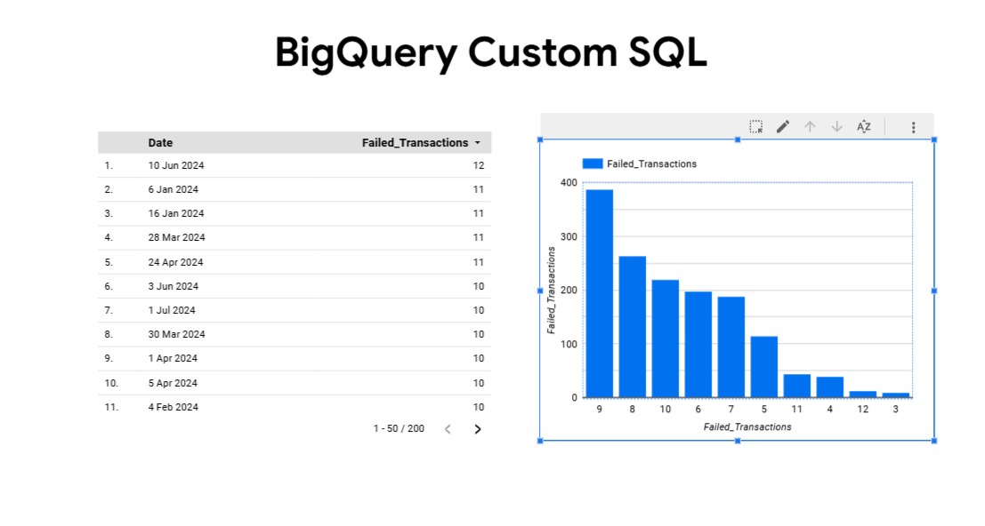
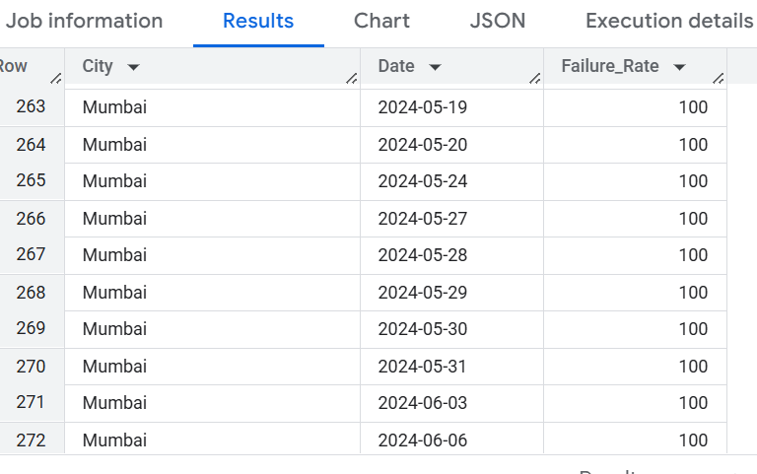
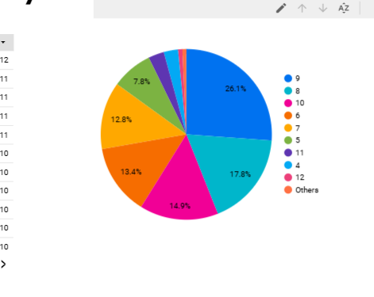
Outcomes
Daily Failed Transactions Trend
SELECT * FROM EXTERNAL_QUERY(
"gcp-dataproc-practice.us.failed_transaction_dataset",
"SELECT Date,
COUNT(*) AS Failed_Count
FROM failed_transactions
WHERE Status = 'FAILED'
GROUP BY Date
ORDER BY Date ASC"
);

Slide 9
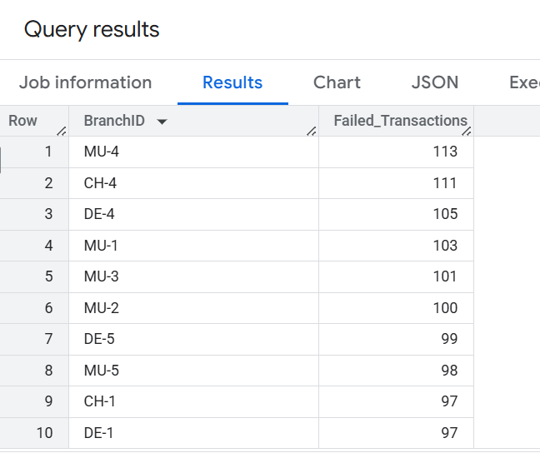
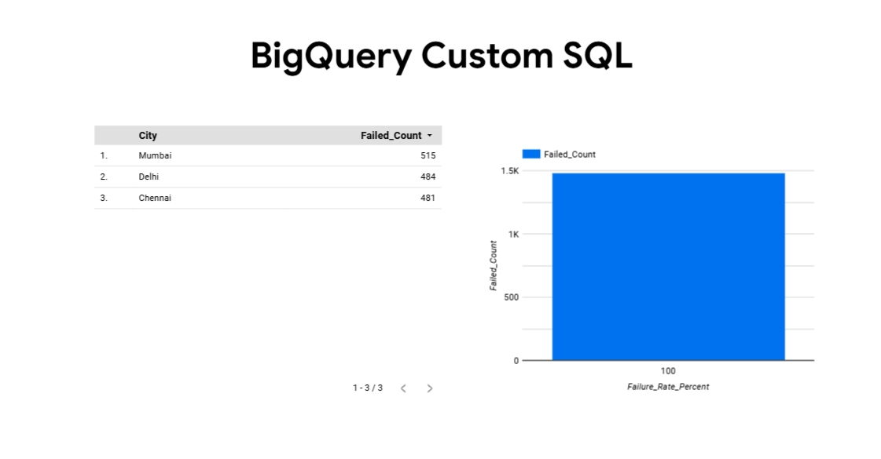
Top Branches with Most Failed Transactions
SELECT * FROM EXTERNAL_QUERY(
"gcp-dataproc-practice.us.failed_transaction_daatset",
"""
SELECT BranchID,
COUNT(*) AS Failed_Transactions
FROM failed_transactions
WHERE Status = 'FAILED'
GROUP BY BranchID
HAVING BranchID IS NOT NULL AND BranchID != 'BranchID'
ORDER BY Failed_Transactions DESC
LIMIT 10
"""
);

Slide 10
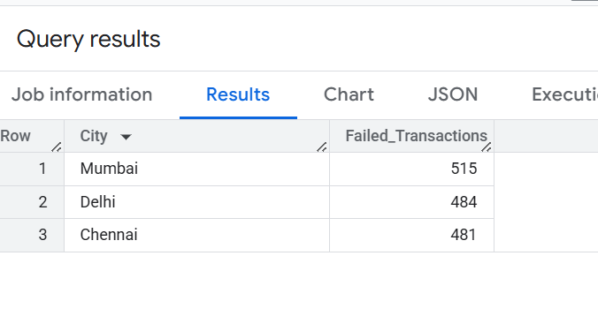
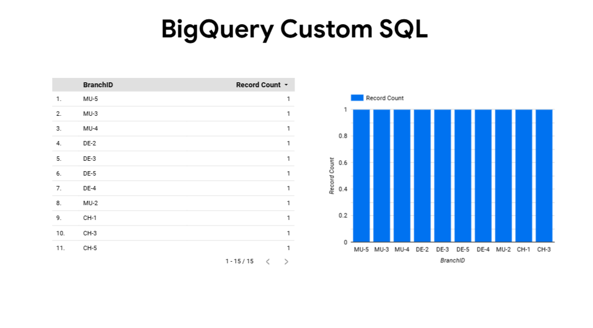
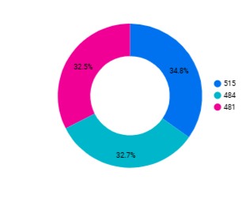
Top 5 Cities with Highest Number of Failed Transactions
SELECT * FROM EXTERNAL_QUERY(
"gcp-dataproc-practice.us.failed_transaction_daatset",
"""
SELECT City,
COUNT(*) AS Failed_Transactions
FROM failed_transactions
WHERE Status = 'FAILED'
GROUP BY City
ORDER BY Failed_Transactions DESC
LIMIT 5
"""
);

Slide 11
Thank You

